Slide 1
Subject: BASIC TECHNOLOGY
Term: FIRST TERM
Session : 2023/2024
Class : GRADE NINE
Educator: Mr. IBEKWE, F.

Slide 2
SCHEME OF WORK
WEEK 1:
REVISION OF LAST TERM WORK
SCALE AND SCALE DRAWING
WEEK 2
WEEK 3:
ISOMETRIC DRAWING
ISOMETRIC DRAWING
WEEK 4
WEEK 5:
OBLIQUE DRAWING
PERSPECTIVE DRAWING
WEEK 6
WEEK 7:
MID TERM BREAK
ORTHOGRAPHIC DRAWING
WEEK 8
WEEK 9:
: BLUE PRINT READING
FAULT DETECTION
WEEK 10
WEEK 11:
REVISION
EXAMINATION
WEEK 12

Slide 3
YR 9: WK 2
Students should be
able to:
use the metric
rule to measure
lengths and compare
sizes.
explain scale
drawings.
identify scales
used in drawing.
draws objects to
given scales
WEEK 2
SCALE AND SCALE DRAWING
HOME

Slide 4
Scale
YR 9: WK 2
TOPIC: Scale and scale drawing
A scale is a ratio which shows the relationship between the size of an object drawn on a paper and its actual size. It is a measure of increasing or decreasing the dimension of an object so that it can be adequately represented on a paper.
A length of 1000metres for instance cannot ordinarily be drawn in a paper as they could hardly be any paper of such dimension. But with a scale of 1cm to 100m, the length of 1000m will give just 10cm. similarly, a scale of 5m for instance implies that 1cm on the drawing represented 5cm of the real object.

Slide 5
YR 9: WK 2
Scale and scale drawing
Scale drawing
This is the process of enlarging or reducing the size of an object so that it can be accommodated on the pages of drawing sheets.
There are occasions where an object will be too large to be drawn on the page of a paper or too small to give its features in details when drawn.
With appropriate scale, these objects can be conveniently represented on a drawing.

Slide 6
YR 9: WK 2
TOPIC: Scale and scale drawing
Types of scale
There are basically three types of scale:
Full scale (ration1:1): In full scale, the object drawn is the same size as the actual object in order words, the objects is drawn full size.
Reduced scale: A reduced scale is used when the size of the object is too big to be containing in a drawing. The drawing of a building for instance can only be done using the reduce scale.
Example of reducing scale include: 1:5, 1:10, 1:20, 1:100 etc. It is important to know that the ratios are in the same unit e.g. mm, cm, m, km etc.
Enlarged scale: An enlarged scale is used when the size of the object is too small to be clearly seen or drawn. They are always of the form 2:1, 3:1, 10:1, 100: 1 etc. In a scale of 5:1 for instance every 5mm on the drawing represent 1mm of the actual size of the object.

Slide 7
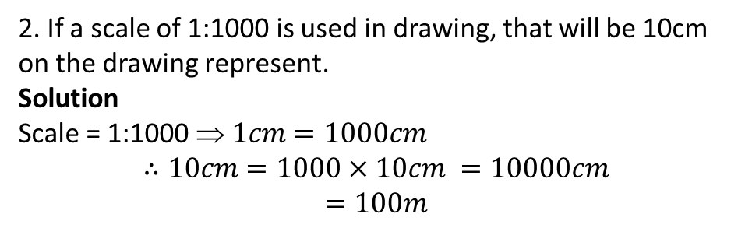
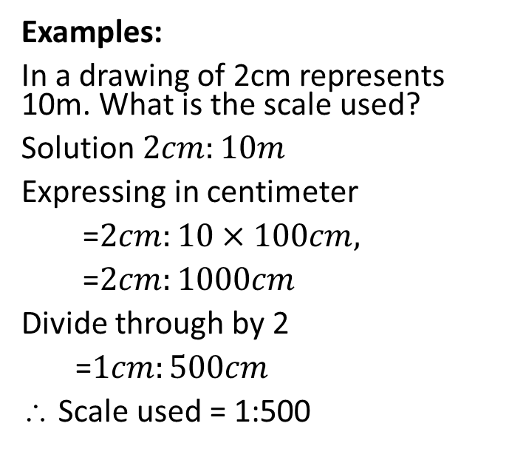
YR 7: WK 2
TOPIC: Scale and scale drawing
Examples:
In a drawing of 2cm represents 10m. What is the scale used?
Solution $2cm:10m$
Expressing in centimeter
=$2cm:10×100cm,$
=$2cm:1000cm$
Divide through by 2
=$1cm:500cm$
∴ Scale used = 1:500
2. If a scale of 1:1000 is used in drawing, that will be 10cm on the drawing represent.
Solution
Scale = 1:1000 $ 1cm=1000cm$
$$∴10cm=1000×10cm =10000cm$$
$$=100m$$

Slide 8
YR 9: WK 2
TOPIC: Scale and scale drawing >> Evaluation
CLASS WORK 2
ASSIGNMENT 2
Question 1
State the forms of scale used in drawing.
Question
Measure the dimension of your school football field. Draw the field to scale 1:1000
Question 2The runway of an airport measures 1.5km. Use an appropriate scale to draw the runway to a new length of 5cm.
Question 3
If a scale of 1:30000 is used in drawing, then 15cm on the drawing will represent what?

Slide 9

Any Questions?

Slide 10
YR 9: WK 3
WEEK 3
PICTORIAL DRAWING:ISOMETRIC DRAWING
Students should be
able to:
identify
Isometric drawings.
use drawing
instruments to draw
simple isometric
objects.
HOME

Slide 11
YR 9: WK 3
TOPIC: ISOMETRIC DRAWING >>
Pictorial projection is a drawing that shows all the three dimensions of an object in the same view. It can be easily understood even by persons without any technical training. But pictorial view does not show the true shape and size of any principal surface of an object and it does not show the hidden portions.
Pictorial projections are easy to imagine so these are used in sales literature.

Slide 12
YR 9: WK 3
TOPIC: ISOMETRIC DRAWING >>
Types of Pictorial Projection:
a. isometric
b. Oblique
c. Perspective
Isometric axes
Isometric drawings are represented on the plane paper or sheet by drawing isometric axes, isometric lines and isometric planes.

Slide 13
Isometric Axes
YR 9: WK 3
TOPIC: ISOMETRIC DRAWING >>
The three lines meeting at the point and making angle of 120 degree with each other
are called isometric axes.

Slide 14
Features of isometric drawing
YR 9: WK 3
TOPIC: ISOMETRIC DRAWING >>
In isometric drawing
there are no true face
all vertical lines are drawn vertically
all horizontal lines are draw at 30⁰ to the base line or horizontal plane
all circle appear as eclipse

Slide 15
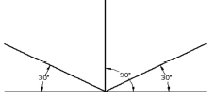
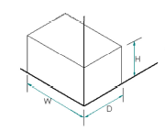
YR 9: WK 3
TOPIC: ISOMETRIC DRAWING >>
draw an isometric axes
measure the lengths according to given dimensions.
erect perpendiculars at and measure the given high
complete the drawing
fit in the hidden edges using dash lines

Slide 16
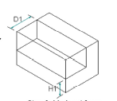
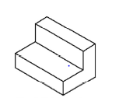
YR 9: WK 3
TOPIC: ISOMETRIC DRAWING >>

Slide 17
YR 9: WK 3
TOPIC: ISOMETRIC DRAWING>> Evaluation
CLASS WORK 3
ASSIGNMENT 3
Question 1
Draw an isometric axis
Question 2
Applying the procedures above draw the cuboids of dimension 50𝑚𝑚×30𝑚𝑚 ×20𝑚𝑚

Slide 18
Any Questions?

Slide 19
YR 9: WK 4
WEEK 4
PICTORIAL DRAWING:ISOMETRIC DRAWING
Students should be
able to:
identify
Isometric drawings.
use drawing
instruments to draw
simple isometric
objects.
HOME

Slide 20
YR 9: WK 4
TOPIC: ISOMETRIC DRAWING >>

Slide 21
YR 9: WK 4
TOPIC: ISOMETRIC DRAWING >>

Slide 22
YR 9: WK 4
TOPIC: ISOMETRIC DRAWING>> Evaluation
CLASS WORK 4
ASSIGNMENT 4
Question
Applying the procedures above draw the blocks in slide1 above
Question 2
Draw the blocks in slide 2 above in isometric

Slide 23
Any Questions?

Slide 24
YR 9: WK 5
Students should be
able to:
describe oblique
drawings.
draw simple
oblique objects
WEEK 5
OBLIQUE DRAWING
HOME

Slide 25
Pictorial drawing: Oblique drawing
YR 9: WK 5
TOPIC: OBLIQUE DRAWING >>
This is another form of three dimensional drawing in which a face is normal to the plane of the paper and the other faces inclined at any convenient acute angle to the horizontal, preferably 45 degree.
Forms of Oblique drawing
Cabinet oblique: all length are true to their dimensions except the oblique length which is usually drawn half the true length .
common oblique: the oblique axis is drawn three quarter (i.e. 75%) of their true length.
Cavalier oblique: here, oblique drawing is made true to the given dimensions. All lengths are drawn 100%. The object appear distorted

Slide 26
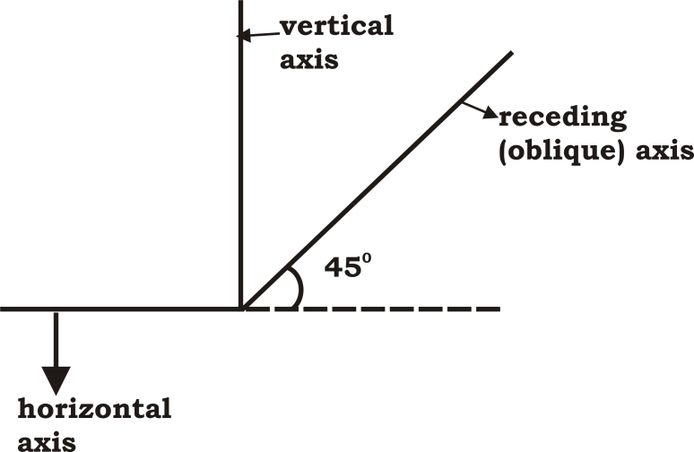
YR 9: WK 5
TOPIC: OBLIQUE DRAWING >>
Oblique axes: as with isometric drawing, oblique drawings are built on oblique axes.
It consist of a vertical line, a horizontal line and an oblique line usually inclined at angle 45 degree to the horizontal
Note that for this class we are only dealing with the cabinet oblique drawing
An oblique axes is shown below

Slide 27
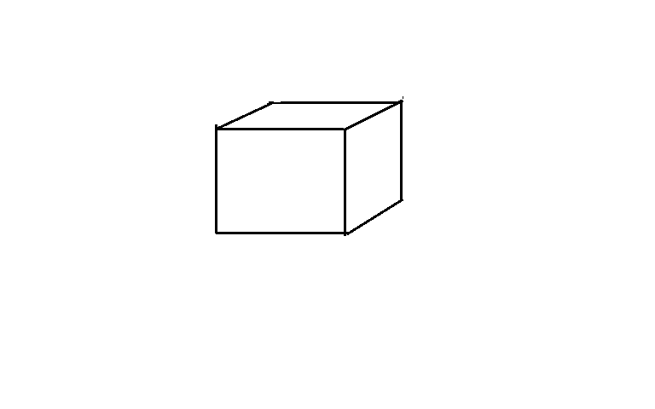
Drawing oblique objects
YR 9: WK 5
TOPIC: OBLIQUE DRAWING >>
Draw a cube of side 30 in oblique
Draw the oblique axes.
Erect perpendiculars
Complete the shape including the hidden details
In all, pay attention to the given dimensions

Slide 28
YR 9: WK 5
TOPIC: OBLIQUE DRAWING>>

Slide 29
YR 9: WK 5
TOPIC: OBLIQUE DRAWING>> Evaluation
CLASS WORK 5
ASSIGNMENT 6
Question 2
Applying the procedures above draw the cuboids of dimension 50𝑚𝑚×30𝑚𝑚 ×20𝑚𝑚
Question 2
Draw the block above in oblique form

Slide 30
Any Questions?

Slide 31
YR 9: WK 6
Students should be
able to:
explain one-point perspective drawing with examples.
state the principles one-point perspective drawing.
make one-point perspective drawing of simple shaped blocks.
WEEK 6
Perspective drawing
HOME

Slide 32
:
YR 9: WK 6
TOPIC: Perspective drawing
This is a kind of pictorial drawing in which the distant part of an object tappers to a point. It is a kind of drawing used to bring distant objects into focus. An object is shown in perspective drawing by projecting lines from the edges to one or more vanishing points. The further the object from the observer the smaller it looks. For instance, a big building appears smaller at some distance from the observer. A tarred road also tends to appear narrower to an observer and seems to terminate in the farthest distance.

Slide 33
YR 9: WK 6
TOPIC: Perspective drawing >>
Terms in perspective drawing
Station point: This is the point or position of the observer. This produces the projectors that runs through the edges of the object
Horizon: This is the line at which the sky tends to meet with the ground.
Vanishing point: This is the point at which all lines (projectors) tend to meet or converge.
Picture plane: This is an imaginary plane through which the observer views the object.
Line of sight: this is the line connecting the observer (or his eyes) to a fixed point on the horizon( the varnishing point)

Slide 34
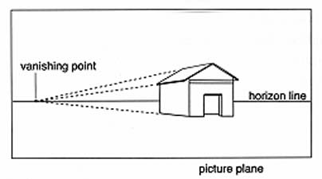
YR 9: WK 6
TOPIC: Perspective drawing >>
Types of perspective drawing
Perspective drawing depends on the number of vanishing points we have
One-point perspective: This is the one with one vanishing point. Lines from the edges of the object arc projected to converge at a vanishing point.

Slide 35
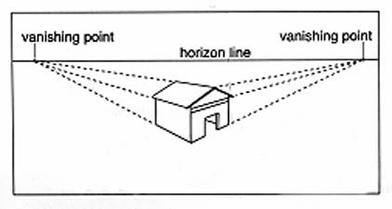
YR 9: WK 6
TOPIC: Perspective drawing >>
Two-point perspective: It has two vanishing points in different direction lines from the edges of the object converge at two vanishing points.

Slide 36
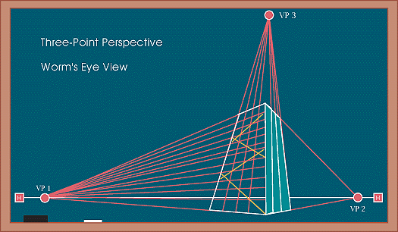
YR 9: WK 6
TOPIC: Perspective drawing >>
Three – point perspective: It has three vanishing points.

Slide 37
YR 9: WK 6
TOPIC: Perspective drawing >>
Examples of one-point perspective
Rail way track: The railway track seems narrower to an observer some distance away, and apparently terminates at the farthest point known as the varnishing point.
A tarred road: When one looks a long stretch of tarred road, it appears to be wider near the observer than further down the length. The road also tends to end in the farthest reach of the eye.
A big building (cathedral): In a big cathedral, the seat arrangement, for instance tends to tapper towards the altar. This is also observed on the internal walls of the building

Slide 38
YR 9: WK 6
TOPIC: Perspective drawing >>
Principles of (Linear) perspective drawing
If two parallel lines are projected indefinitely in a straight line, they tend to converge at a point called the varnishing point.
Equal distances between objects tend to look closer as these objects recede away from the observer.
Objects of the same size or height appear smaller or shorter the more their distance away from the observer.
The further away an object is from the observer the smaller it looks.

Slide 39
YR 9: WK 6
TOPIC: Perspective drawing >> Evaluation
CLASS WORK 6
ASSIGNMENT 6
Question 1
What is a perspective drawing?
Question 1
Make a perspective drawing of a cuboids measuring 50 by 30 by 20.
Question 2
Mention the types of perspective drawing
Question 2
Explain the following terms in perspective drawing.
Varnishing point
Station point
Horizon line
Question 3
Mention four principles of one-point perspective drawings.

Slide 40
Any Questions?

Slide 41
YR 9: WK 8
Students should be
able to:
explain the
meaning of
orthographic
projection.
identify
components of
orthographic
projection.
describe the
principal views in
quadrants.
draw the
orthographic views of
simple objects.
WEEK 8
Orthographic drawing
HOME

Slide 42
Orthographic drawing
YR : WK 8
TOPIC: Orthographic drawing >>
Orthographic drawing is the drawing a 3-dimensional object in 2 dimension.
In other words, an orthographic drawing is a collection of 2-dimensional drawings that work together to give an accurate overall description of an object.
Components of orthographic drawing
Principal planes
There are two principal planes of projection- the vertical plane and the horizontal plane. When the two planes intersect; four quadrants are formed.

Slide 43
YR 9: WK 8
TOPIC: Orthographic drawing >>
Principal views
A maximum of six views can be used to describe objects which are the front view, back view, right hand side view, left hand side view top view and bottom view. For a simple object, a minimum of two views is enough to convey an adequate description.

Slide 44
YR 9: WK 8
TOPIC: Orthographic drawing >>
Types of orthographic projection
There are two methods of orthographic projection. They are
First angle projection and
Third angle projection
The difference between them lies in the relative position of the views in the planes/quadrants.

Slide 45
YR 9: WK 8
TOPIC: Orthographic drawing >>
First angle projection (British method):
In 1st angle projection, the top view (plan) is directly below the front elevation. The front view is usually placed in the vertical plane while the plane is in the horizontal plane. The side views are contained in the auxiliary vertical plane

Slide 46
YR 9: WK 8
TOPIC: Orthographic drawing >>
Third angle projection:
In the third angle projection, the front elevation is directly below the plan. it is exactly the opposite in arrangement to the first angle projection as shown below

Slide 47
Activity
YR 9: WK 8
TOPIC: Orthographic drawing >>
Draw the orthographic views of the block below using any preferred method.
i On a plain drawing sheet, draw the border line 10-15mm from the edges.
ii Draw the title block showing all relevant information- name, class, school, title, date etc.
iii The front view (view containing the most detail)
iv The side elevation
v The plan

Slide 48
YR 9: WK 8
TOPIC: Orthographic drawing >>
Draw the orthographic views of the figure below

Slide 49
YR 9: WK 8
TOPIC: Orthographic drawing >> Evaluation
CLASS WORK 8
ASSIGNMENT 8
Question
Activity shown above
Question 2
See the slide above

Slide 50
Any Questions?

Slide 51
YR 9: WK 9
Students should be
able to:
interpret
symbols can plans
and blue-prints.
identify the
components of a
building plane.
draw and
interpret the plan of
their classroom
WEEK 9
BLUEPRINT OF BUILDINGS
HOME

Slide 52
YR 9: WK 9
TOPIC: Blue print>> INTRODUCTION
Blue print
The blue print of a building is the photographic print of the building plan drawn with while line on blue background. A typical blue print consist of the following drawing
site plan
floor plan
elevations
sectional drawings
electrical and plumbing installations,
Blue print (building plan) reading is therefore, the process of identifying and interpreting the symbols used in any building drawing.

Slide 53
Blue print drawing techniques
YR 9: WK 9
TOPIC: Blue print
Draw the floor plan to given specification
Locate on the plan every structure in the building – such as mechanical, electrical and plumbing items using standard symbols.
Draw the elevations- fronts, rear and side elevations. Note that in elevation, certain features appear natural, not in symbols e.g. doors, windows.
Draw also the sections which show the internal details of the building when cut by a cutting plan. Features of the building cut by the plane appear in section while others appear in elevation.

Slide 54
YR 9: WK 9
TOPIC: Blue print
Building symbols
These are standard conventions by which any/every item is represented symbols on building plans can be divided into:
mechanical
electrical
plumbing
The table shows some common symbols ad their conventional representations.

Slide 55
YR 9: WK 9
TOPICBlue print
Building components | Symbols
wood Glass
Concrete
Hardcone
Wall (sectioned)
window
door
sink
water closet
stair case
wardrobe
bath
wash hand basin
water heater
switch
socket outlet
filament bulb
fluorescent
shower
soak away/septic tank

Slide 56
YR 9: WK 9
TOPIC: Blue print
CLASS WORK 9
ASSIGNMENT 9
Question 2
What is a blue print?
Draw the plan of your classroom to scale 1:200 showing all the features/fitting.
Question 3
List at least five components of a blue print.
Question 3
Question 4Show the symbols for the following doors, windows, tabs, socket outlet and sink.
Question 4

Slide 57
Any Questions?

Slide 58
YR 9: WK 10
Students should be
able to:
Explain the meaning of fault detection (trouble shooting)
Identify and select the tools for fault defection
WEEK 10
FAULT DETECTION
HOME

Slide 59
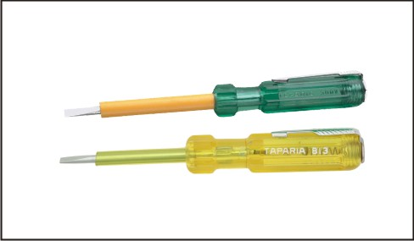
YR 9: WK 10
TOPIC: FAULT DETECTION >> INTRODUCTION
FAULT DEFECTION (TROUBLE SHOOTING)
Fault defection, also known as trouble-shooting, is the process of detecting (finding), locating and fixing (rectification) using special tools. It involves measurements and tests, and sometimes checks for signs damaged, or burnt out components, bridged cuts, dry joints etc.
TOOLS FOR FAULT DEFECTION
1. TESTER- the simplest and commonest instrument for detecting electric current. The circuit is completed by placing a finger on the cap of the handle while touching the tip on a current carrying conductor.

Slide 60
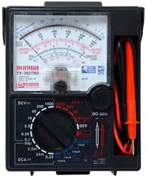
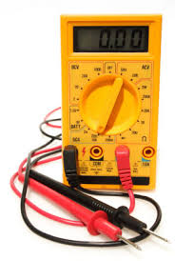
YR 9: WK 10
TOPIC: FAULT DETECTION >> INTRODUCTION
2. ANALOGUE OR DIGITAL METER:- This could be an ammeter, voltmeter, ohmmeter or a multi meter in analogue meters, the deflection of the pointer gives indication of measured quantity while digital meters display values of such quantities.

Slide 61
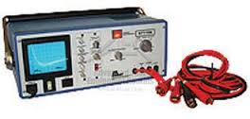
YR 9: WK 10
TOPIC: FAULT DETECTION >> INTRODUCTION
3.Cathode ray oscilloscope:- An important in trouble shooting and maintenance of electronic equipment. it can be to view signal wave forms generated or flowing through any section of a complex circuit

Slide 62
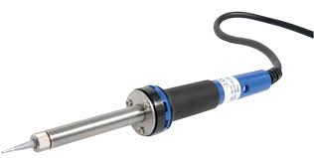
YR 9: WK 10
TOPIC: FAULT DETECTION >>
Soldering iron:- used for soldering or de-soldering component of electronic circuits
5.Service manual/user guide:- contain such important information as basic operation of the system and its maintenance procedures. It should be supplied by the manufacturer of the product.

Slide 63
YR 9: WK 10
TOPIC: FAULT DETECTION >> Evaluation
CLASS WORK 10
ASSIGNMENT 10
Question 1
Define the term troubleshooting
Question 1
Describe the use of the cathode ray oscilloscope in fault detection
Question 2
Mention any five instruments used in fault detection
Question 2
Mention any five electronic gadgets that may require troubleshooting

Slide 64
Any Questions?

